Slide 1
MGMT 59000: air force budget insights extraction Armand Debray

Slide 2
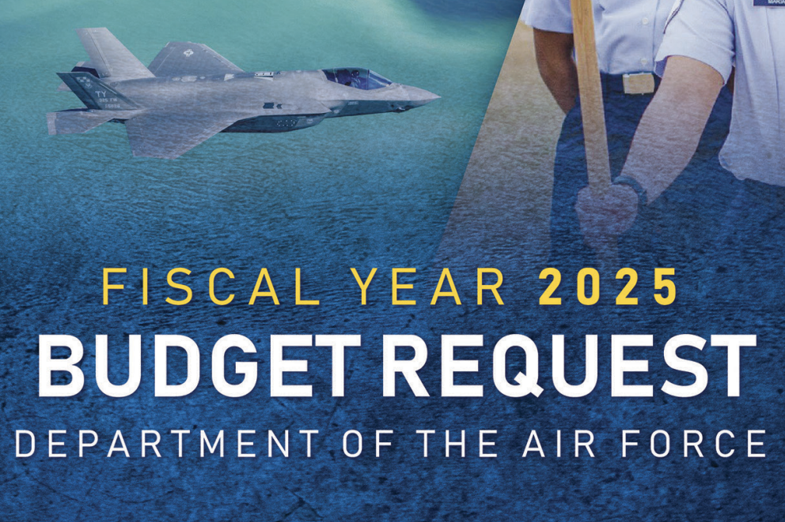
intro
Every year, the Air Force needs to request funds from Congress. It does this in the form of a congressional budget request. Up until 2013, the Air Force used to release statistics regarding pay, retention, recruitment in a single localized document. For this project, I decided to analyze this data to extract insights.

Slide 3
OVERVIEW
Business Problem
Exploratory Data Analysis
Model Formation
Business Insights

Slide 4
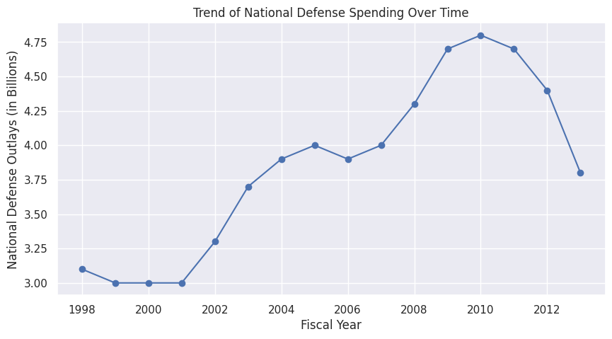
First Data Visualization

Slide 5
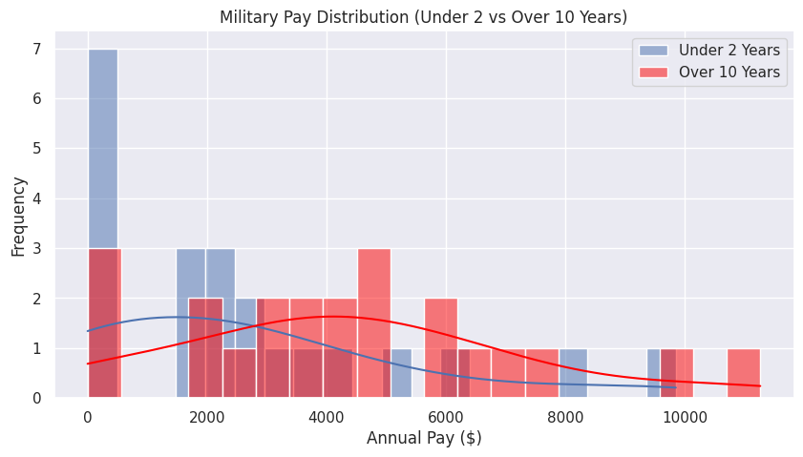
Second data visualization

Slide 6
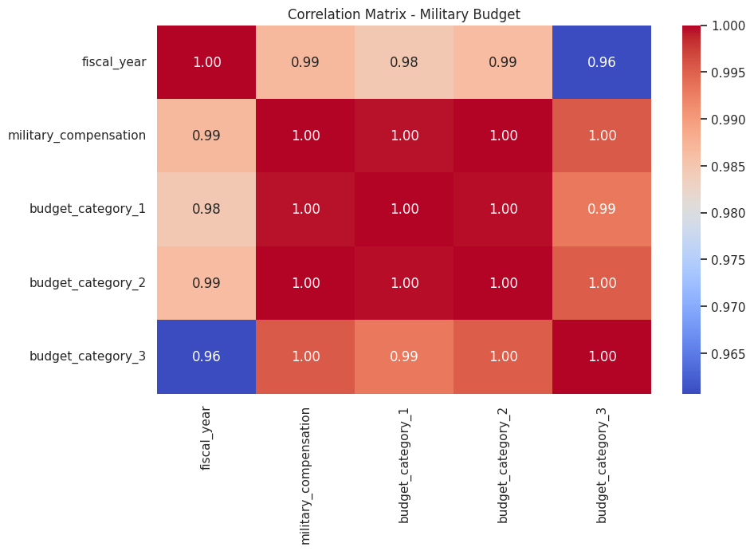
THIRD data visualization

Slide 7
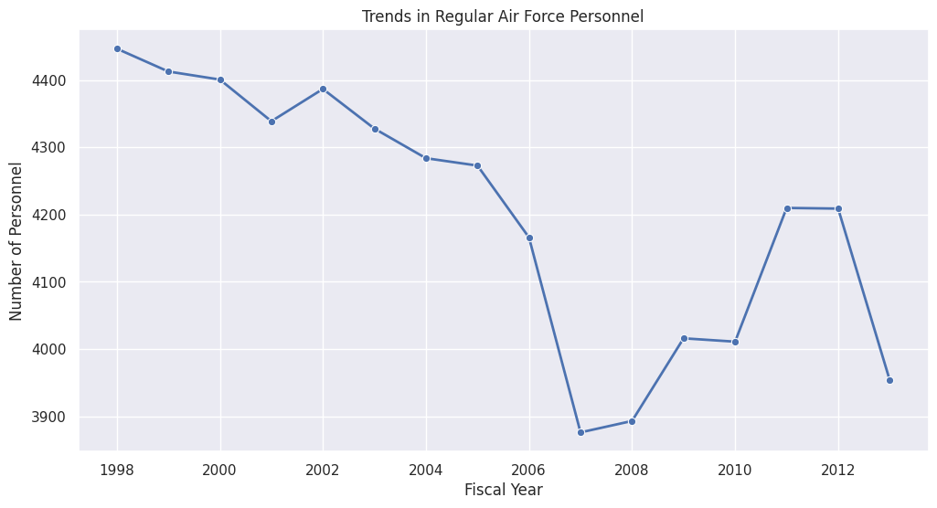
FOURTH data visualization

Slide 8
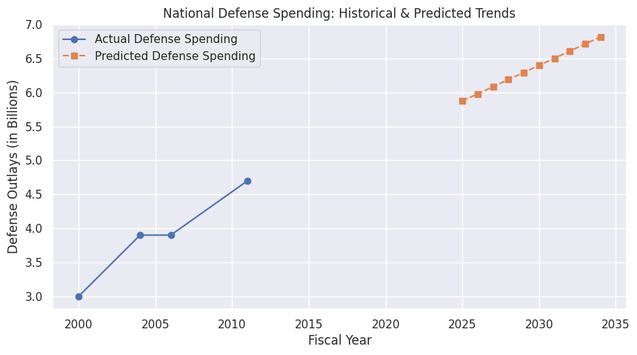
Model formation
Root Mean Squared Error (RMSE): 0.224
Pretty accurate, but not perfect
It is predicting an increase of DOD spending to around $700 billion

Slide 9
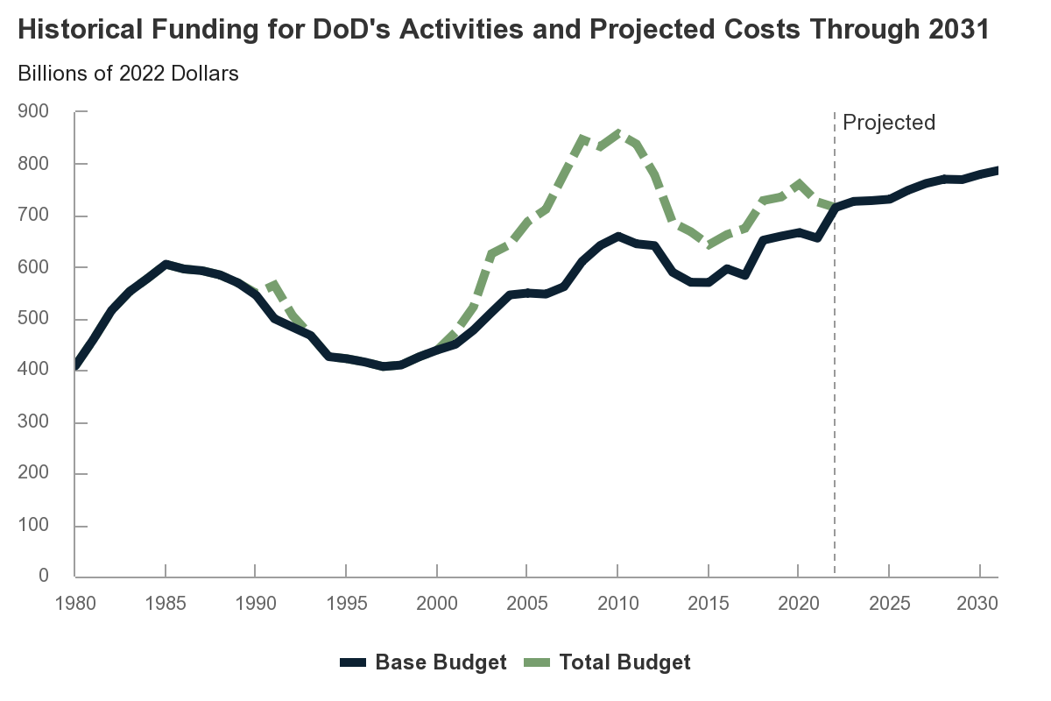
First regression model real life?
The model predicted an increase of DOD spending to around $700 billion
In real life, spending increased to around $750 to $800 billion by 2020
The model actually accurately predicted this based on past data – success!

Slide 10
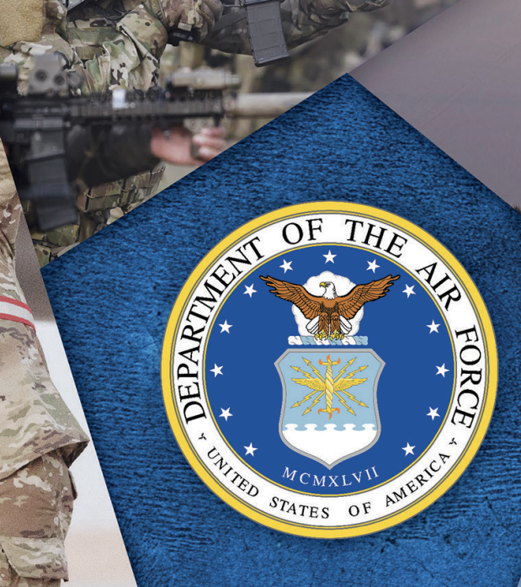
BUSINESS INSIGHTS
What can be fixed?

Slide 11
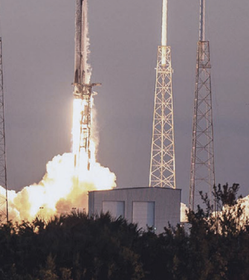
Pay Strategy for retention
The military pay model highlights that significant pay raises only occur after 10 years of service.
This is an issue within the military and has been for a long time.
Matter-of-fact, rebuilding pay grades and ways to effectively recompense military members has been a challenge for decades.
Recommendation: A more gradual pay increase earlier in service could improve recruitment & retention efforts.

Slide 12

DATA DRIVEN BUDGET ALLOCATION
Clustering analysis confirms that budget spending is highly correlated across different
Recommendation: Future Air Force budget requests should consider proportional adjustments based on historical patterns & projected needs rather than arbitrary increases.
FUN FACT: This is reflected more in modern FY 2025 congressional budget requests, with the Air Force now having the largest budget due to huge aircraft programs.

Slide 13

USING MODELS TO FORECAST MILITARY NEEDS
Predictive models indicate a potential future personnel decline while spending continues to rise.
Recommendation: Decision-makers should investigate efficiency improvements, such as automated systems & training programs, to offset personnel shortages without inflating costs.

Slide 14
Challenges
What to fix?

Slide 15
DATA QUALITY AND UPDATES
Many datasets were from 2013, which limits the relevance of our forecasts. I wished the Air Force continued to release these statistical reports into 2025 however considering the sensitive nature of DOD operations I knew this would be a difficult topic to broach.
Solution: Incorporating real-time budget data from the DoD could improve accuracy.

Slide 16
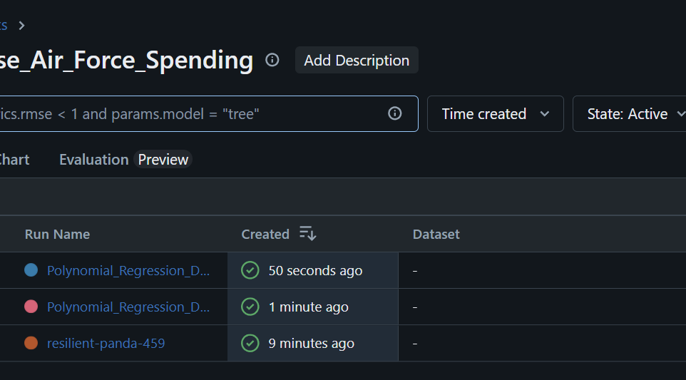
More advanced prediction + Automated ml
Polynomial regression performed better than linear models, but time-series forecasting (ARIMA, LSTMs) could further improve long-term predictions.
While MLflow successfully tracked experiments, automated pipeline integration for continuous learning should be explored.
This would be a huge time saver in terms of labor costs and efficiency (especially for my poor coding hands).

Slide 17
SUMMARY
Business Problem
Exploratory Data Analysis
Model Formation
Business Insights

Slide 18

Thank you
Armand Debray
480-274-8738
debray@purdue.edu

